Slide 1

Credit Card Customer Segmentation Analysis
A Data-Driven Approach to Understanding Customer Behavior
- Supriya K Kushwaha

Slide 2
Project Overview
Business Objective:
Analyze 8,950 credit card customers
Identify distinct customer segments
Create actionable customer personas
Drive targeted marketing strategies
Methodology:
K-means clustering
Principal Component Analysis
Behavioral pattern analysis

Slide 3
Table of Contents
Credit Utilization Analysis
Customer Balance Patterns
Cash Advance Behavior
Purchase Patterns
Customer Personas
Strategic Recommendations
Implementation Plan

Slide 4
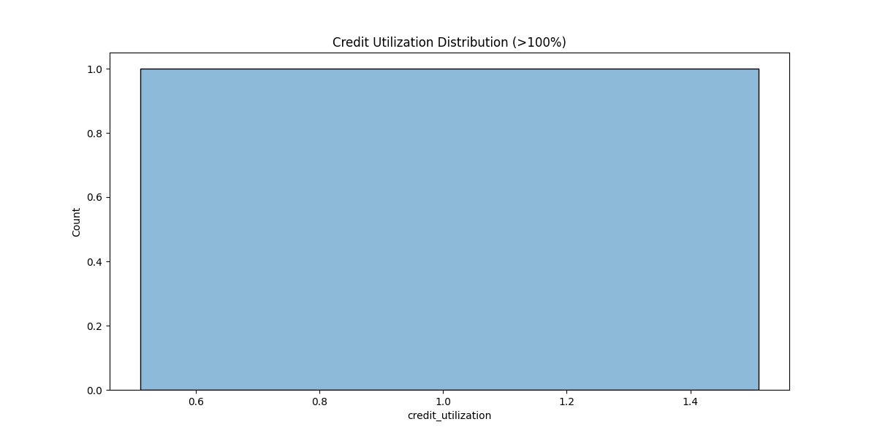
Credit Utilization Overview
Credit Utilization Distribution >100% graph
Key Findings:2.6% customers exceed credit limits
Risk identification opportunity
Need for proactive credit management

Slide 5
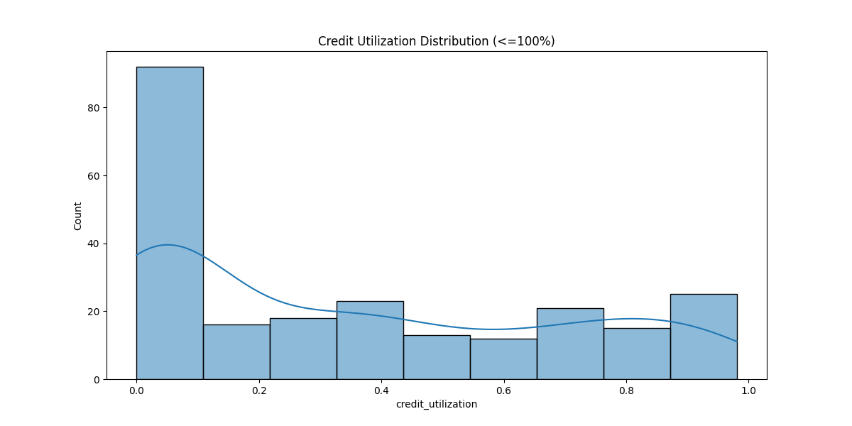
Credit Usage Distribution
Credit Utilization Distribution <=100% graph
Distribution Analysis:Peak at 0-20% utilization (90+ customers)
Secondary peaks at 40% and 80%
Clear segmentation opportunities
Healthy credit usage by majority

Slide 6
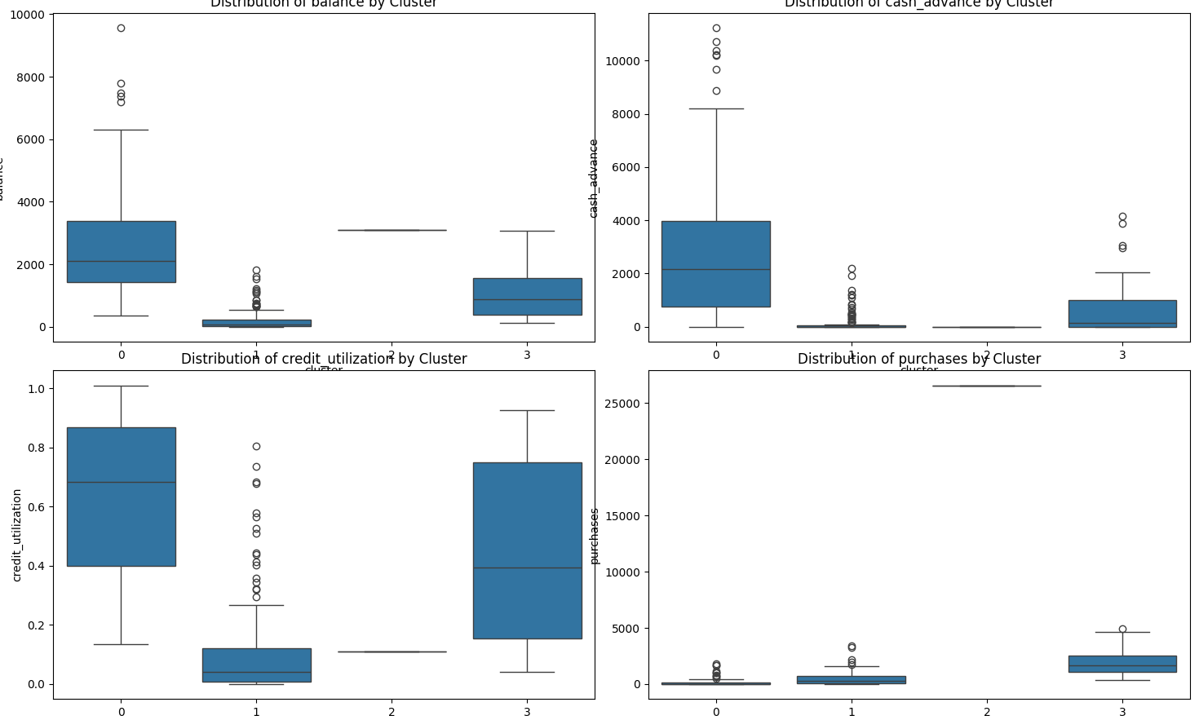
Balance Distribution Analysis
Distribution of balance by Cluster box plot Cluster Insights:
Cluster 0: High-balance users ($2,000 median)
Cluster 1: Conservative users (<$500)
Cluster 3: Moderate users ($500-$1,500)
Outliers reaching $9,000

Slide 7
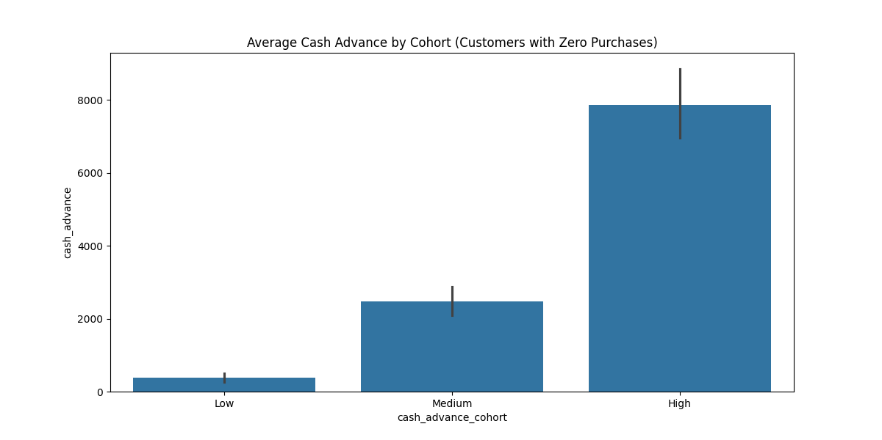
Cash Advance Patterns
Distribution of cash_advance by Cluster box plot Usage Patterns:
Cluster 0: Heavy users ($2,000-$8,000)
Cluster 1: Minimal usage
Cluster 3: Moderate usage ($500-$2,000)
Risk management opportunities

Slide 8
Credit Utilization by Segment
Distribution of credit utilization by Cluster box plot Segment Analysis:
Cluster 0: 40-85% utilization
Cluster 1: Below 20% typical
Cluster 3: 15-75% range
Clear behavioral differences

Slide 9
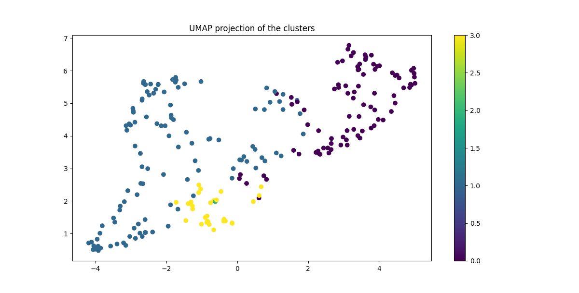
Purchase Behavior
Distribution of purchases by Cluster box plot Purchase Insights:
Cluster 2: Highest spenders
Cluster 0: Consistent moderate spending
Clusters 1 & 3: Conservative buyers
Opportunity for targeted rewards

Slide 10
Strategic Recommendations
Targeted Approaches:
Premium services for Cluster 0
Activation campaigns for Cluster 1
Rewards program for Cluster 2
Balance transfer offers for Cluster 3

Slide 11
Conclusion
Key Achievements:
Successfully identified 4 distinct segments
Created actionable customer personas
Developed targeted strategies
Impact:
Enhanced customer understanding
Data-driven decision making
Clear path for personalized marketing
Risk management framework established

